Slide 1
Student Management System
Student Details

Slide 2
INTRODUCTION OF MY PROJECT
The main objective of the Student Management System is to manage the list of student details
It manage the details of the students such as First name, last name and email id of the student
We can add the details of student by clicking add button and same way we can delete the student details in an effective manner.

Slide 3
SCOPE OF THE PROJECT
CREATE STUDENT MODULE
In this module, We can create the student details by adding respective student name and email id .
LIST STUDENT MODULE
List of the students that have been added and summit are displayed in this module and we can update and delete the details.

Slide 4
TECHNOLOGY USED
BACKEND TECHNOLOGY
MYSQL
SPRINGBOOT
FRONDEND TECHNOLOGY
HTML
BOOTSTRAP

Slide 5
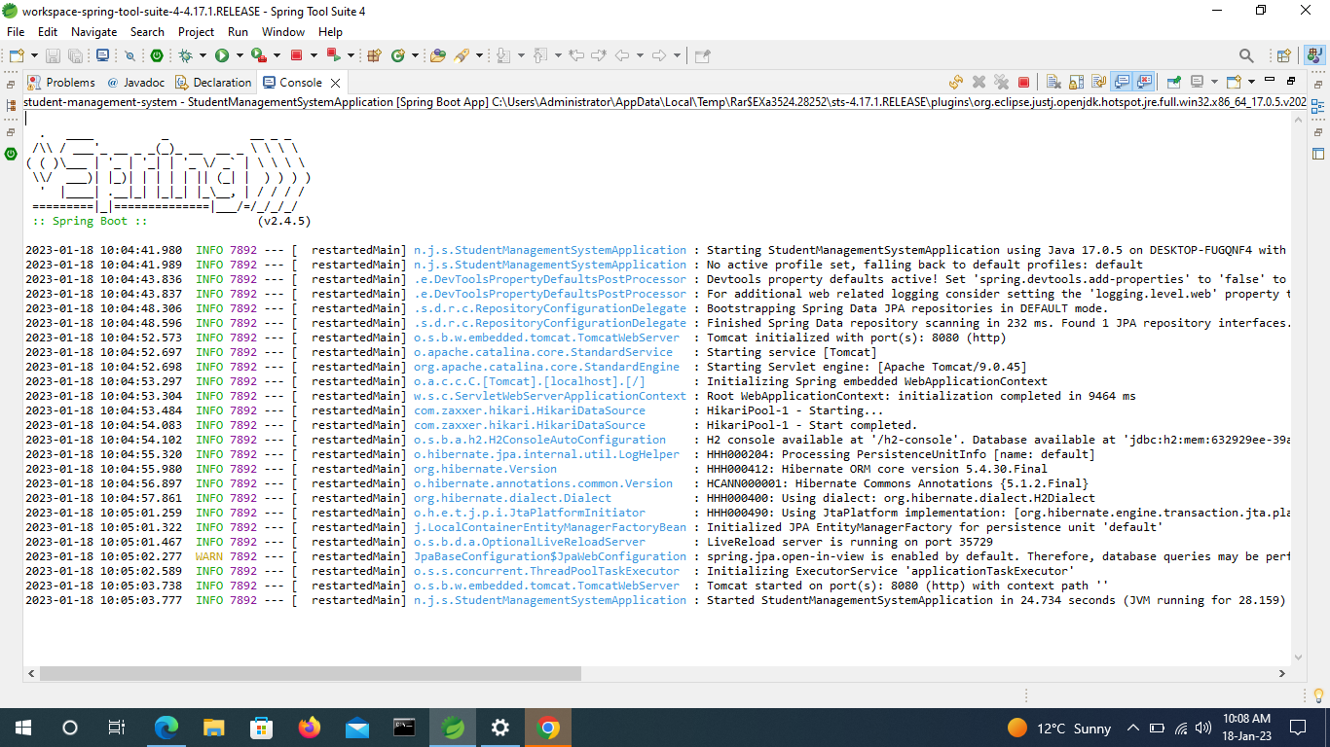
BACKEND RUNNING STATUS

Slide 6
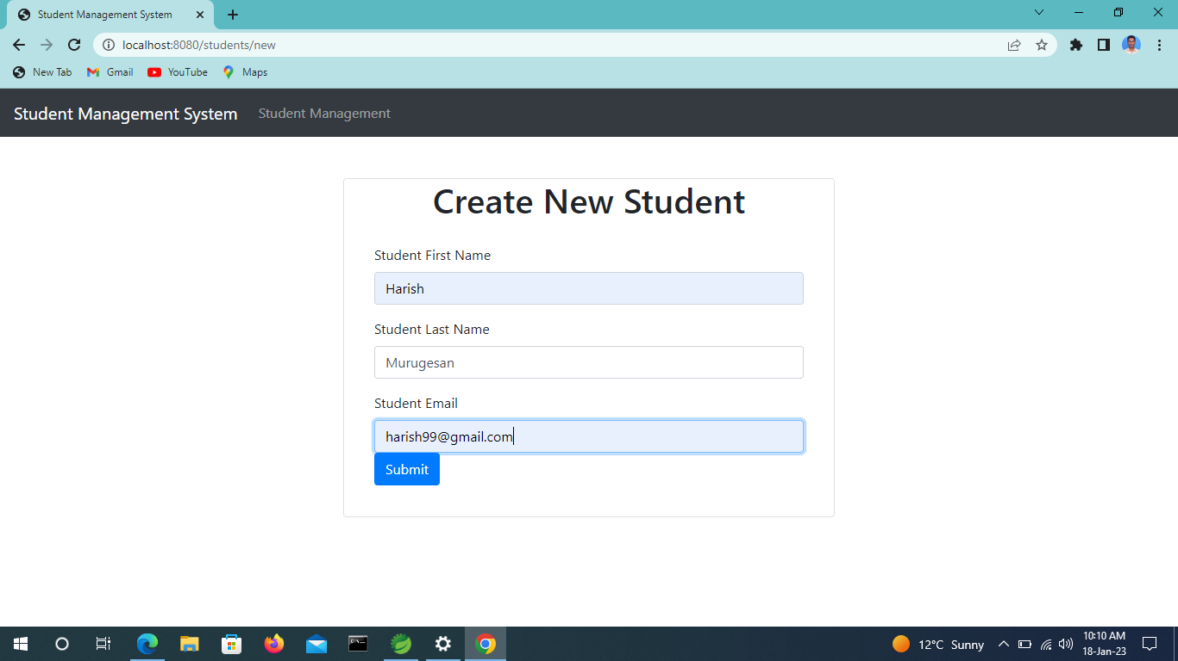
ADD STUDENT

Slide 7
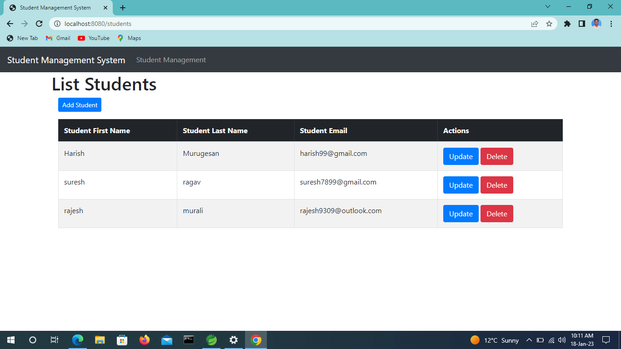
STUDENT LIST

Slide 8


